Slide 1
Add these terms to your glossary please ☺
Artefact = an object made by a human being, typically one of cultural or historical interest.
Barter = exchange (goods or services) for other goods or services without using money.
Chainmail = flexible armour consisting of small metal rings linked together.
Why Study History? - YouTube

Slide 2
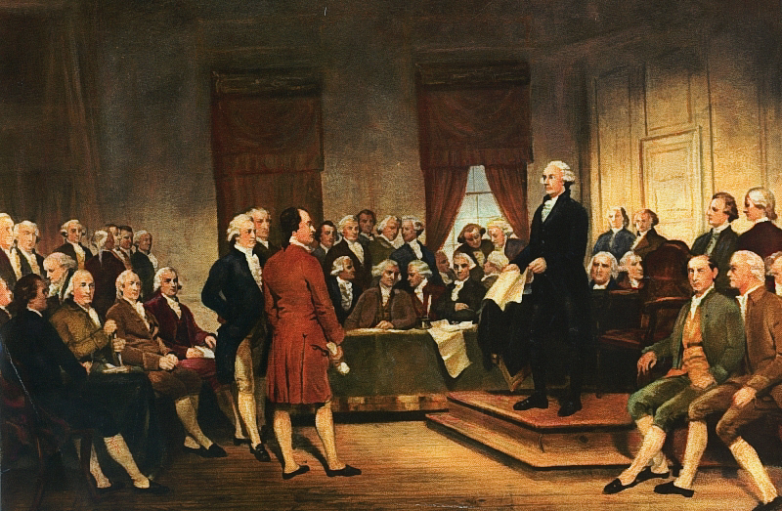
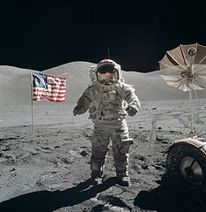
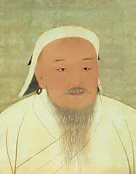
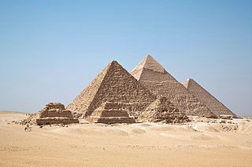
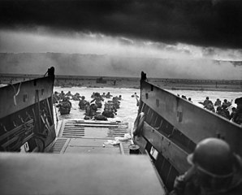
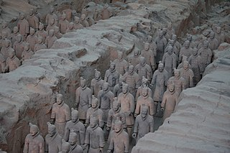
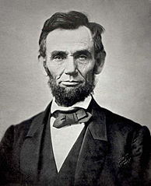
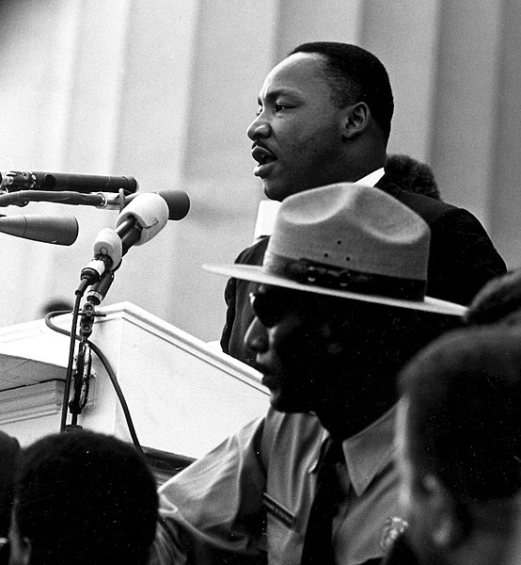
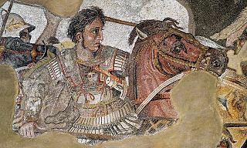
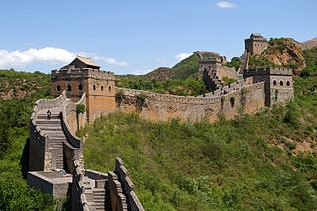
What is History?
How Do We Know What We Know?
Notes:
Signing of the Constitution: Junius Brutus Stearns [Public domain], via Wikimedia Commons
Pyramids: By Ricardo Liberato (All Gizah Pyramids) [CC BY-SA 2.0 (https://creativecommons.org/licenses/by-sa/2.0)], via Wikimedia Commons
Genghis Khan: National Palace Museum [Public domain], via Wikimedia Commons
Moon landing: By NASA / Harrison H. Schmitt (NASA Images at the Internet Archive (image link)) [Public domain], via Wikimedia Commons
Abraham Lincoln: Alexander Gardner [Public domain], via Wikimedia Commons
D-Day: National Archives and Records Administration [Public domain], via Wikimedia Commons
Great Wall of China: By Jakub Hałun (Own work) [GFDL (http://www.gnu.org/copyleft/fdl.html) or CC BY-SA 3.0 (https://creativecommons.org/licenses/by-sa/3.0)], via Wikimedia Commons
Terracotta army: By Maros M r a z (Maros) (Own work) [GFDL (http://www.gnu.org/copyleft/fdl.html), CC-BY-SA-3.0 (http://creativecommons.org/licenses/by-sa/3.0/) or CC BY-SA 2.5-2.0-1.0 (https://creativecommons.org/licenses/by-sa/2.5-2.0-1.0)], via Wikimedia Commons
MLK image: [Public domain], via Wikimedia Commons

Slide 3

What is History?
History can be defined as:
The study of the past
A record of past events and times
The branch of knowledge dealing with past events
The study of history is based on written records
Notes:
Image: By Lin Kristensen from New Jersey, USA (Timeless Books) [CC BY 2.0 (http://creativecommons.org/licenses/by/2.0)], via Wikimedia Commons

Slide 4
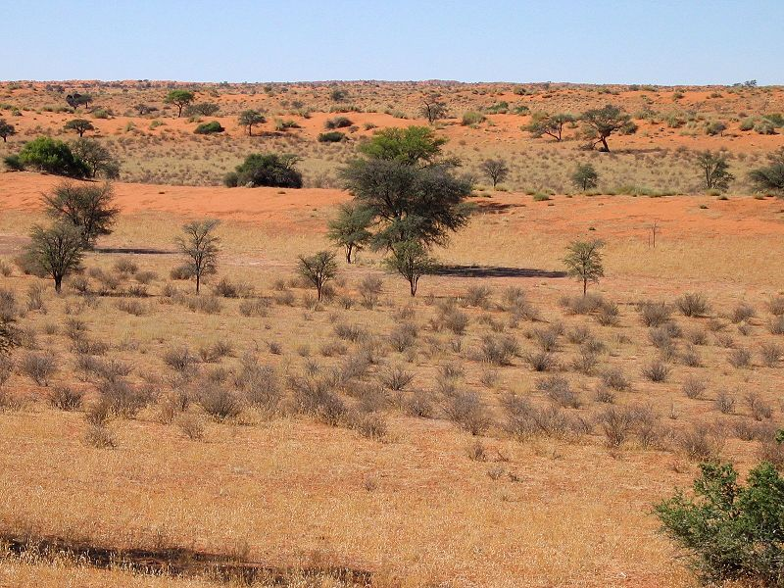
Events before history
Events that occurred before written records are considered prehistory
Prehistory covers humans’ first use of stone tools approximately 3.3 million years ago to the invention of writing systems approximately 5300 years ago
Notes:
Image: By Harald Süpfle (photo taken by Harald Süpfle) [CC BY-SA 2.5 (https://creativecommons.org/licenses/by-sa/2.5)], via Wikimedia Commons

Slide 5
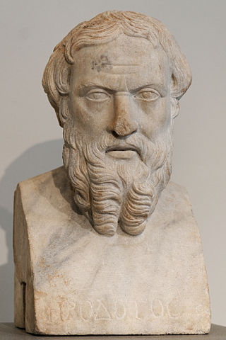
Historians
A historian is a person who studies and writes about the past
Historians evaluate source materials for meaning and accuracy
Source materials are considered either primary or secondary
Greek historian Herodotus is often referred to as “the father of history”
Notes:
Image: Marie-Lan Nguyen / Wikimedia Commons, via Wikimedia Commons

Slide 6
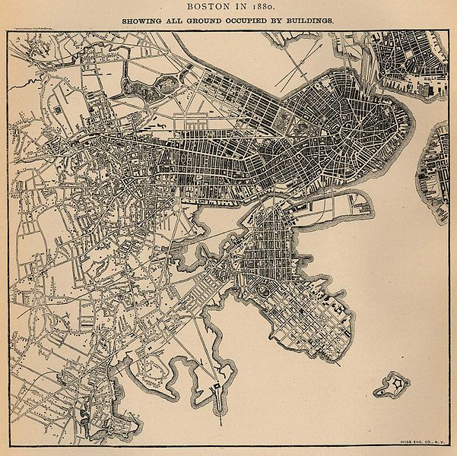
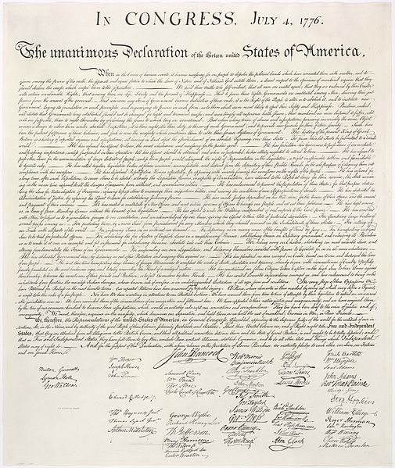
Primary Sources
A primary source provides direct or firsthand evidence about an event, object, or person
Primary sources were created at the time under study and serve as an original sources of information
Notes:
From left to right: a map of Boston in 1880, the Declaration of Independence, Martin Luther King Jr. delivering his “I Have a Dream” speech.
Boston map: https://commons.wikimedia.org/wiki/File:Boston_ground_1880.jpg
MLK image: [Public domain], via Wikimedia Commons

Slide 7
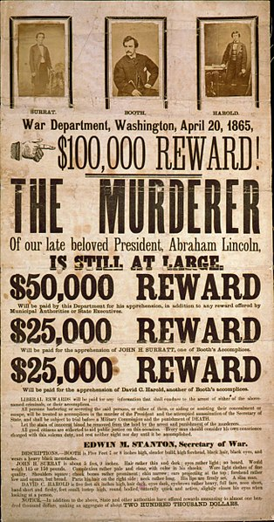
Primary Sources
Primary sources can include:
Historical documents
Autobiographies
Eyewitness accounts
Diaries
Legal documents
Maps
Interviews
And more
Notes:
Image: [Public domain, Public domain or Public domain], via Wikimedia Commons

Slide 8

Secondary Sources
A secondary source relates or discusses information originally presented elsewhere
Secondary sources typically have many copies and can be found in libraries, schools, or homes
Notes:
Image: By Stewart Butterfield (flickr) [CC BY 2.0 (http://creativecommons.org/licenses/by/2.0)], via Wikimedia Commons

Slide 9

Secondary Sources
Secondary sources can include:
History textbooks
Biographies
Encyclopedias
Essays or reviews
And more
Notes:
In addition to primary and secondary sources, a third category, tertiary sources, is sometimes included. Tertiary sources include
Image: By Rocket000 [Public domain], via Wikimedia Commons

Slide 10

How do we know what we know about the past?
In addition to evaluating primary and secondary sources, historians can turn to other types of experts for aid in understanding their subject, including:
Geographers
Archaeologists
Anthropologists
And more
Notes:
Image: https://www.publicdomainpictures.net/view-image.php?image=159735&picture=globe-clipart-illustration

Slide 11
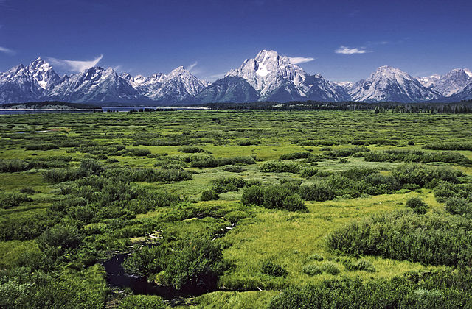
Geographers
Geographers study Earth’s natural environment and human society
Physical geographers study the natural environment
Human geographers study human society
Notes:
Image: I, Michael Gäbler [CC BY 3.0 (http://creativecommons.org/licenses/by/3.0)], via Wikimedia Commons

Slide 12
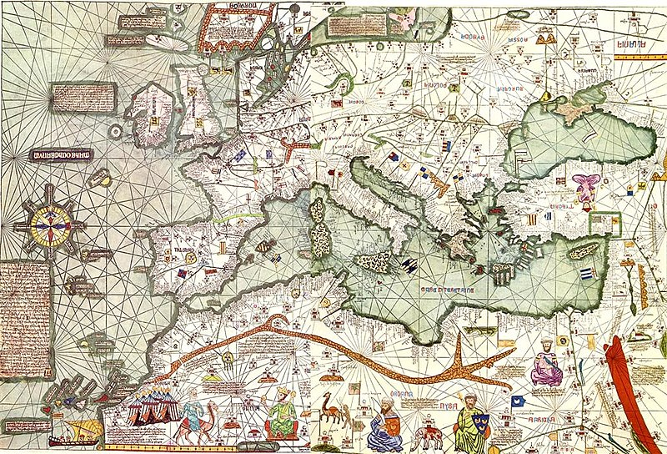
Geographers
Cartography, the study and practice of making maps, can be considered a part of the field of geography
Map making increased in importance in the 15th and 16th centuries as explorers began traveling to new areas
Notes:
The background is a map of Europe from 1375
Image: By Cresques Abraham (Unknown) [Public domain], via Wikimedia Commons

Slide 13
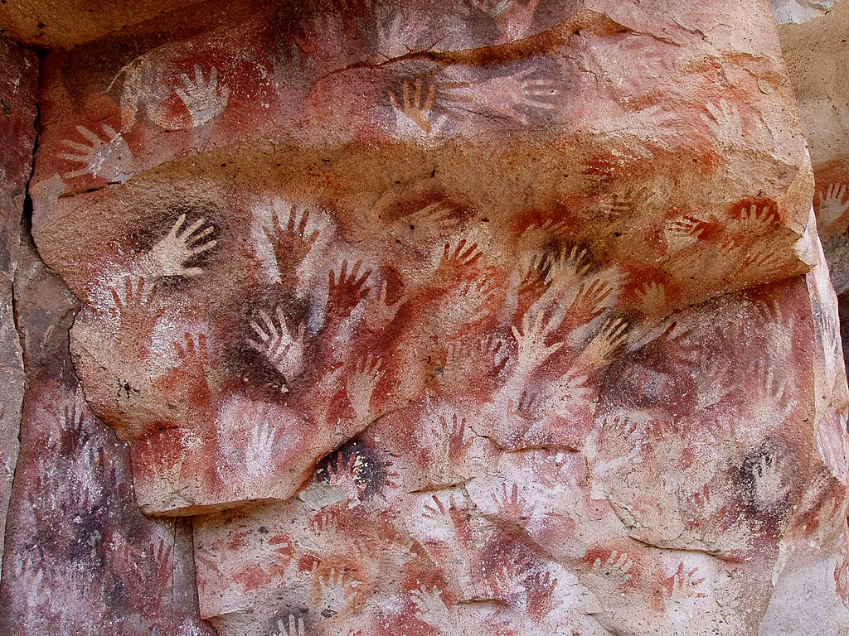
Anthropologists
Anthropologists study the origins of humans and human behavior and societies in past and present
Social anthropology is the study of the norms and values of societies
Biological anthropology studies the biological development of humans
Notes:
Pictured is Cueva de las Manos in Perito Moreno, Argentina. The art in the cave is between 13,000–9,000 years old.
Image: By Mariano (Own work) [GFDL (http://www.gnu.org/copyleft/fdl.html), CC-BY-SA-3.0 (http://creativecommons.org/licenses/by-sa/3.0/) or CC BY-SA 2.5 (https://creativecommons.org/licenses/by-sa/2.5)], via Wikimedia Commons

Slide 14
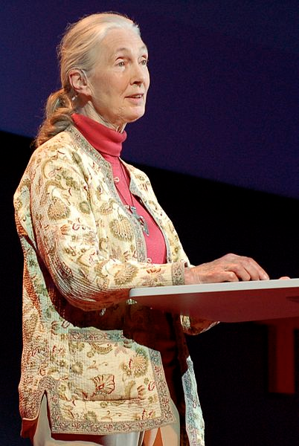
Anthropologists
Some anthropologists may live for years at a time with native peoples to study how they live
Some anthropologists may study species similar to humans, such as apes
Anthropologist and primatologist Jane Goodall has spent over 50 years studying the interactions of chimpanzees
Notes:
Image: By Erik (HASH) Hersman from Orlando (File:Jane Goodall at TEDGlobal 2007.jpg) [CC BY 2.0 (http://creativecommons.org/licenses/by/2.0)], via Wikimedia Commons

Slide 15
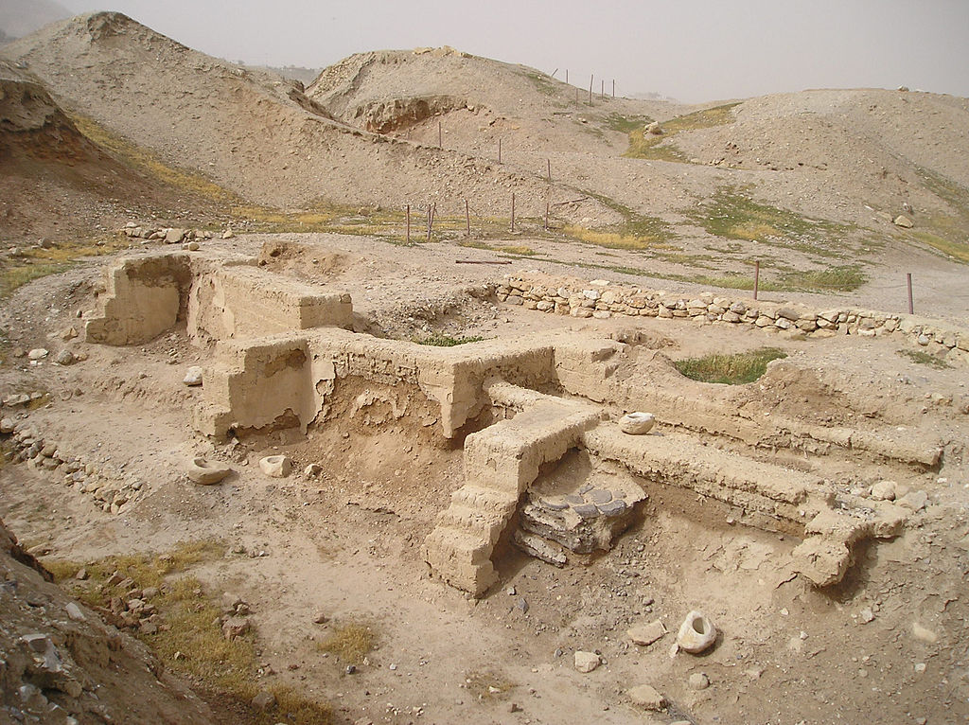
Archaeologists
Archaeologists study prehistoric peoples and their cultures by examining their artifacts, monuments, and other physical materials
Notes:
Archaeology is sometimes considered a sub-field of anthropology
Image: By A. Sobkowski (Own work) [Public domain], via Wikimedia Commons

Slide 16
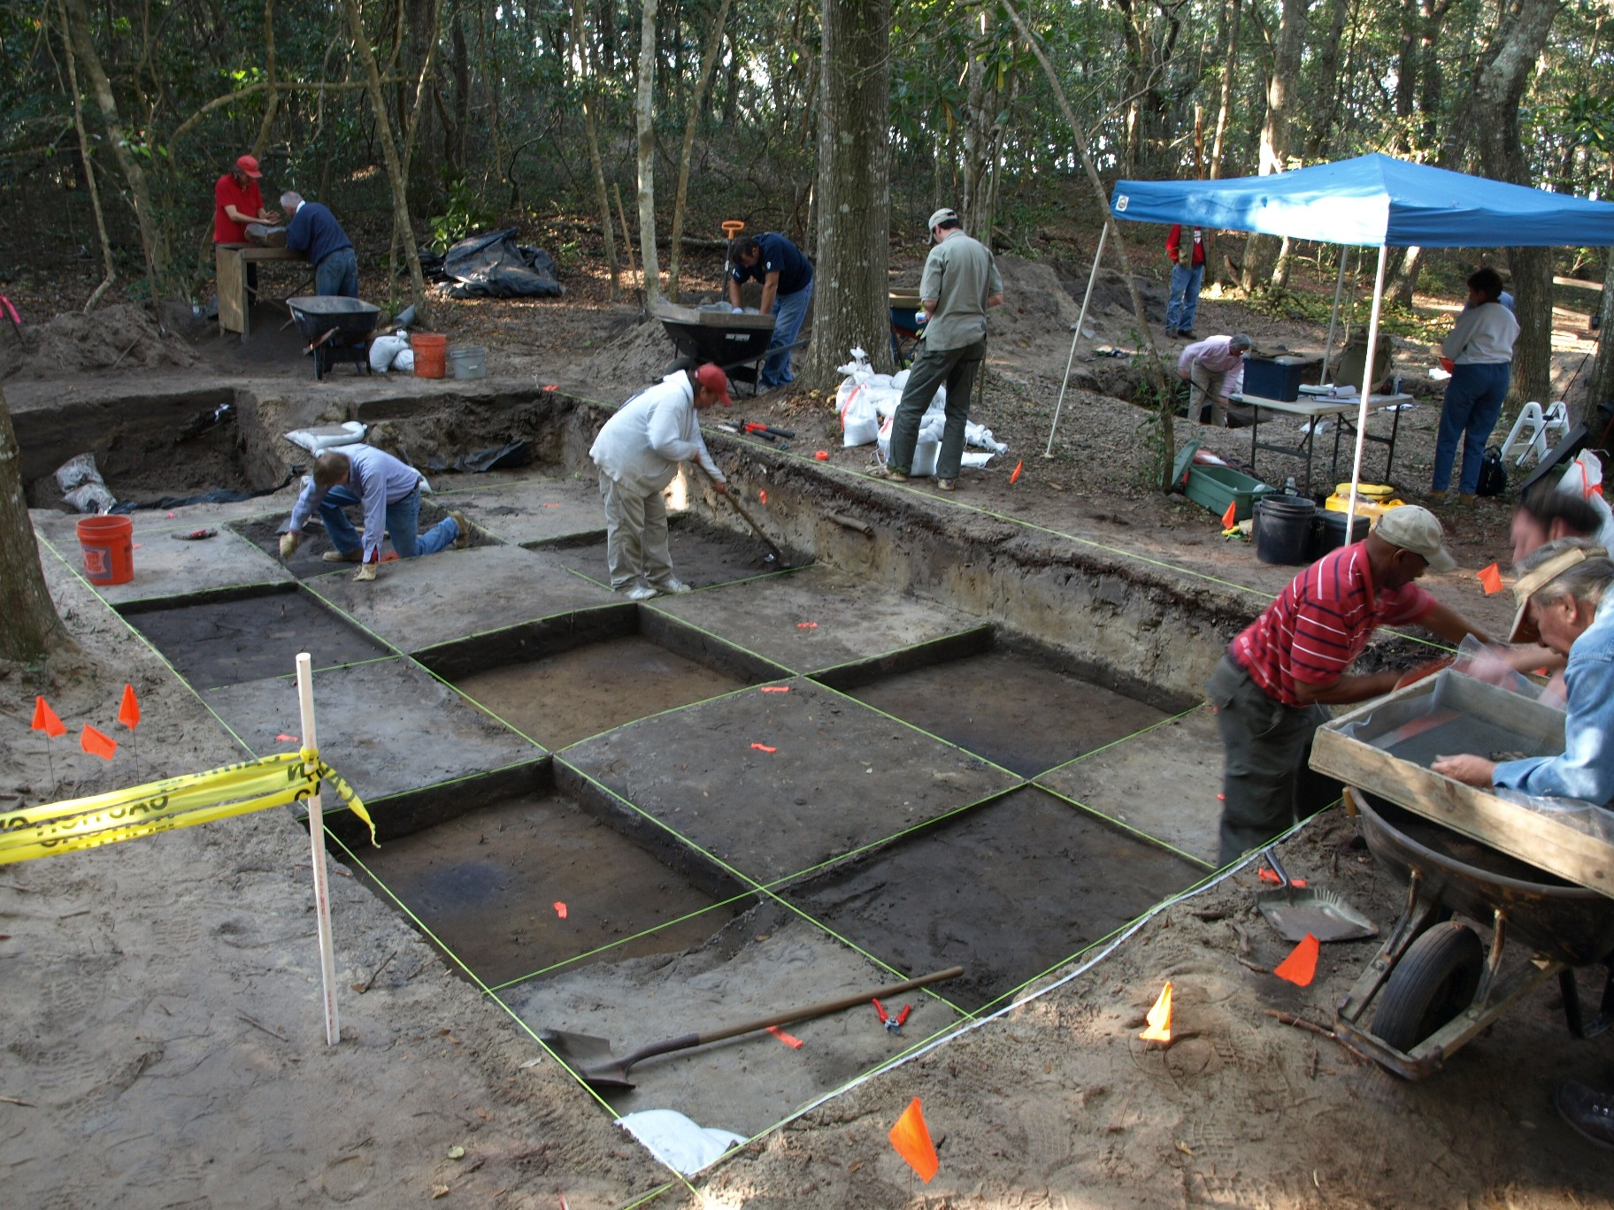
Archaeologists
Before digging for artifacts, archaeologists will map a site, dividing it into squares
More recent remains usually lie near the surface, older remains beneath
Newer techniques such as ground penetrating radar help archaeologists determine where to dig
Notes:
Image: National Park Service

Slide 17

Archaeologists
Famous archaeological discoveries include:
The Teracotta Army (pictured)
Pompeii
King Tut’s Tomb
The Rosetta Stone
And more
Notes:
Image: [Public domain], via Wikimedia Commons

Slide 18
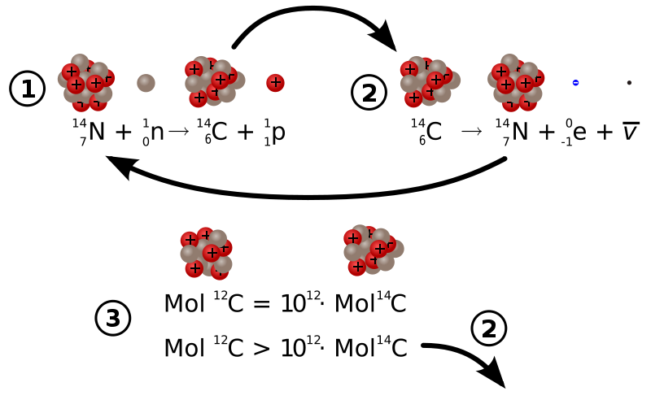
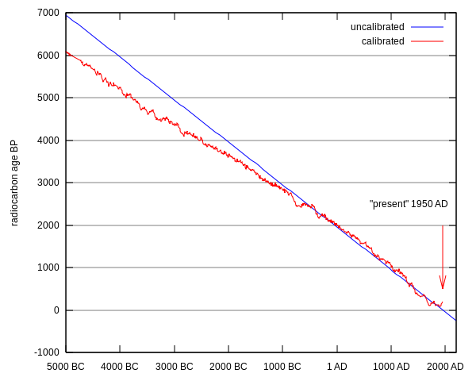
Archaeologists
The age of organic material up to 50,000 years old can be determined through carbon dating, which measures radioactive decay
Using carbon dating, archaeologists can put together a worldwide timeline of human activity
Carbon 14 formation and decay
Notes:
Carbon dating measures the radioactive decay of carbon-14. When plants and animals die, carbon 14 continues to decay.
Graph: [Public domain], via Wikimedia Commons

Slide 19
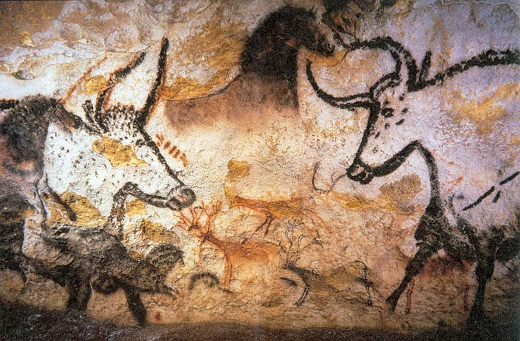
Why study history?
History can help us:
Understand and appreciate other people and societies
Develop an identity by learning our past
Become productive citizens
Learn from past successes and mistakes
Notes:
Image: By Prof saxx (Own work) [GFDL (http://www.gnu.org/copyleft/fdl.html), CC-BY-SA-3.0 (http://creativecommons.org/licenses/by-sa/3.0/) or Public domain], via Wikimedia Commons

